Slide 1


FACE ANONYMIZATION FOR PRIVACY PRESERVATION
GUIDED BY
Mr. DS BHUPAL NAIK
Asst. Professor, CSE
Vignan University
PRESENTED BY
171FA04298 (SK MS SAMEER)
171FA04339 (K BHANU MURTHI)

Slide 2



INTRODUCTION
There is an increasing concern in computer vision devices invading the privacy of their users.
We want the camera systems/robots to recognize important events and assist human daily life by understanding its videos, but we also want to ensure that they do not intrude people's privacy.

Slide 3
ABSTRACT
In this project,
Our goal is to get a generator network to generate new images of faces that look as realistic as possible.
The project will be broken down into a series of tasks from loading in data to defining and training adversarial networks.
At the end, we will be able to visualize the results of our trained Generator to see how it performs
our generated samples should look like fairly realistic faces with small amounts of noise.

Slide 4
GETTING THE DATA
We will be using the ”Celeb faces Attributes” Dataset to train our adversarial networks.
This dataset is more complex than the number datasets (like MNIST or SVHN) we have been working with, and so, we should prepare to define deeper networks and train them for a longer time to get good results. It is suggested that you utilize a GPU for training.
The “CelebA” dataset contains over 200,000 celebrity images with annotations. Since you're going to be generating faces, you won't need the annotations, you'll only need the images. Note that these are color images with 3 color channels (RGB) each.

Slide 5
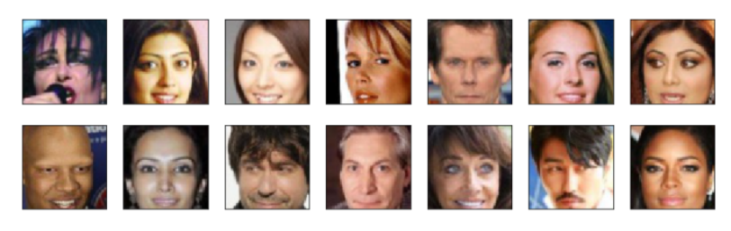
PREPROCESSING
Since the project's main focus is on building the GANs, we have done some of the pre-processing here.
Each of the CelebA images has been cropped to remove parts of the image that don't include a face, then resized down to 64x64x3 NumPy images.
Some sample data is show below.

Slide 6
DATA LOADER
Our images should be square, Tensor images of size image_size x image_size in the x and y dimension.
Our function should return a Data Loader that shuffles and batches these Tensor images.
You can decide on any reasonable batch_size parameter
Your image_size must be 32. Resizing the data to a smaller size will make for faster training, while still creating convincing images of faces!

Slide 7
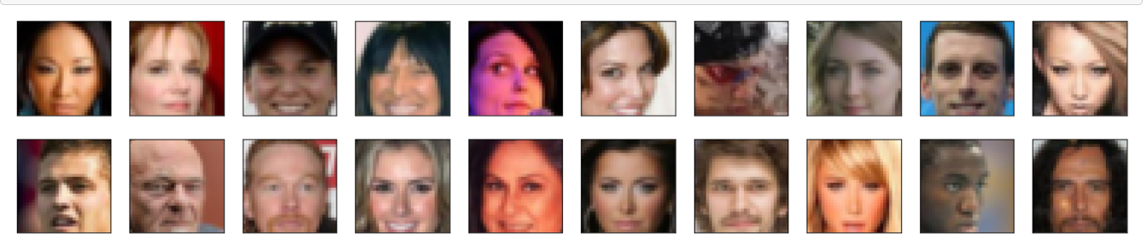
Next, we can view some images. We should seen square images of somewhat-centered faces.
Note: We need to convert the Tensor images into a NumPy type and transpose the dimensions to correctly display an image, suggested imshow code is below, but it may not be perfect.
def imshow(img):
npimg = img.numpy()
plt.imshow(np.transpose(npimg, (1, 2, 0)))

Slide 8
GENERATIVE ADVERSARIAL NETWORKS (GANs)
Created in 2014 by Ian Goodfellow
Why Gans ?
Insufficient labelled training data
Use generated data as is image/audio synthesis
Why is it Adversarial ? It’s a competition between 2 components
Generator :Replicates real data to produce fake data.
Discriminator : Distinguishes real data from fake data.
Discriminator loss is passed to Generator as an objective function.
In this project, we have used DCGAN Model

Slide 9
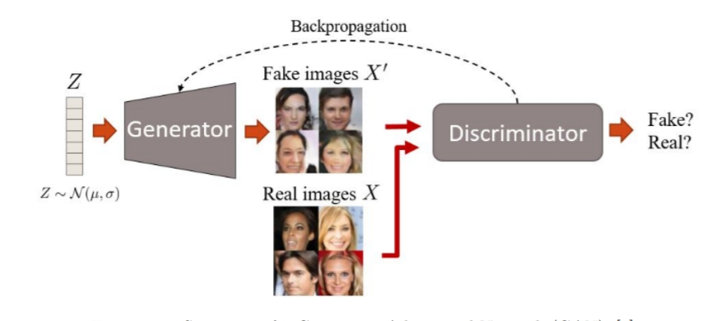
STEPS TO TRAIN A GAN
Define a problem
Define GAN Architecture
Train Discriminator on Real Image
Generate Fake Inputs for Generator
Train Discriminator On Fake image
Train Generator with the output of Discriminator.
Once training is complete, synthesize data from Generator
Eg: https://thispersondoesnotexist.com/

Slide 10
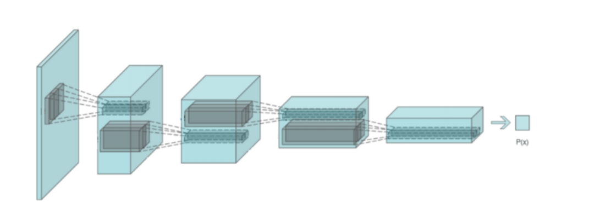
DISCRIMINATOR
Our first task will be to define the discriminator.
This is a convolutional classifier like we have built before, only without any maxpooling layers. To deal with this complex data, we use a deep network with normalization. we are also allowed to create any helper functions that may be useful.
The inputs to the discriminator are 32x32x3 tensor images
The output should be a single value that will indicate whether a given image is real or fake

Slide 11
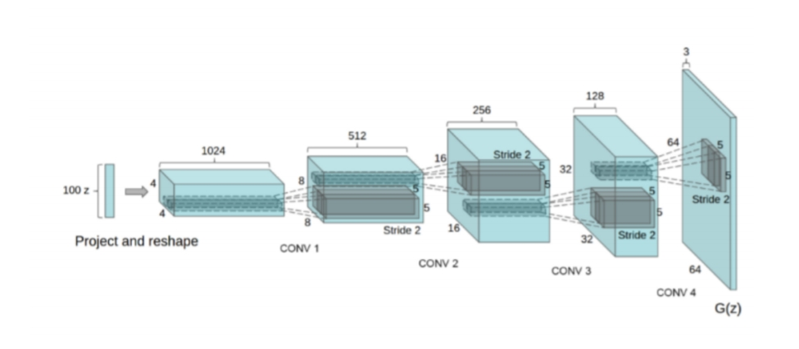
GENERATOR
The generator should upsample an input and generate a new image of the same size as our training data 32x32x3. This should be mostly transpose convolutional layers with normalization applied to the outputs.
The inputs to the generator are vectors of some length z_size
The output should be a image of shape 32x32x3

Slide 12
WEIGHT INITIALIZATION FUNCTION
This should initialize only convolutional and linear layers
Initialize the weights to a normal distribution, centered around 0, with a standard deviation of 0.02.
The bias terms, if they exist, may be left alone or set to 0.

Slide 13
DISCRIMINATOR AND GENERATOR LOSSES
Now we need to calculate the losses for both types of adversarial networks.
DISCRIMINATOR LOSSES
For the discriminator, the total loss is the sum of the losses for real and fake images
d_loss = d_real_loss + d_fake_loss.
Remember that we want the discriminator to output 1 for real images and 0 for fake images, so we need to set up the losses to reflect that.
GENERATOR LOSSES
The generator loss will look similar only with flipped labels.
The generator's goal is to get the discriminator to think its generated images are real.

Slide 14
TRAINING
Training will involve alternating between training the discriminator and the generator. We have used our functions real_loss and fake_loss to calculate the discriminator losses.
We should train the discriminator by alternating on real and fake images
Then the generator, which tries to trick the discriminator and should have an opposing loss function
We have set a number of training epochs and trained our GAN

Slide 15
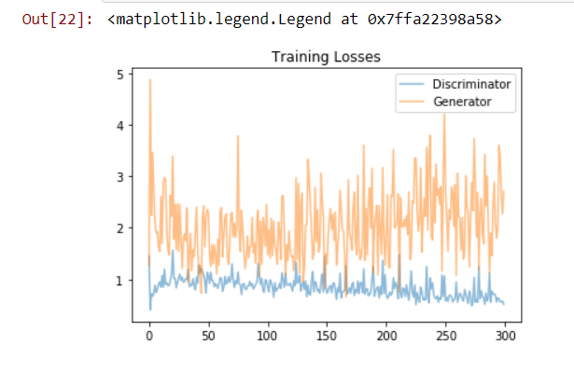
TRAINING LOSS
We have plotted the training losses for the generator and discriminator and recorded after each epoch

Slide 16
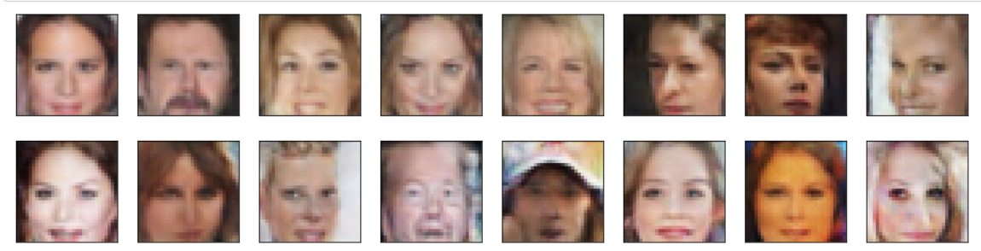
Analysis of generated Samples from Training
We may say that the dataset is lightly biased . But, not to a large extent. we can understand it from the sample images printed at beginning.
That might be the reason why most of the generated images are mostly white.
I even observed that adding an extra layer and increasing the depths of convolution layers made the losses to converge to a better loss.
I think larger models have the opportunity to learn more features in the data feature space.
I think using Adam as optimiser yielded good results. The number of epochs also effected the final result.
I think training for larger number of epochs, making the size of model larger and using a more diverse dataset might improve this model.

Slide 17
FUNCTIONAL/NON-FUNCTIONAL REQUIREMENTS
Functional Requirements :-
After getting valuable information we reached to the following important conclusions: -
1. It should meet the functional requirements as mentioned in Objectives. 2. It should be able to handle 'gif' and 'jpeg’ images.
Non-functional Requirements :-
This project is intended to meet the following non functional requirements: -
1) This face anonymization software should be available on the Internet, to enable the users to use , download it any time. 2) The program should be platform independent.

Slide 18
SOFTWARE/HARDWARE REQUIREMENTS
Software Requirements
Operating System : Windows XP or higher / Mac OS X 10.5.8 or later / Linux
Language: Python
Application: Google Colaboratory
Hardware Requirements
Processor : Pentium 4 or Higher, (PIV-300GHz)
RAM : 4GB
Hard disk : 1TB
Ethernet : LAN

Slide 19
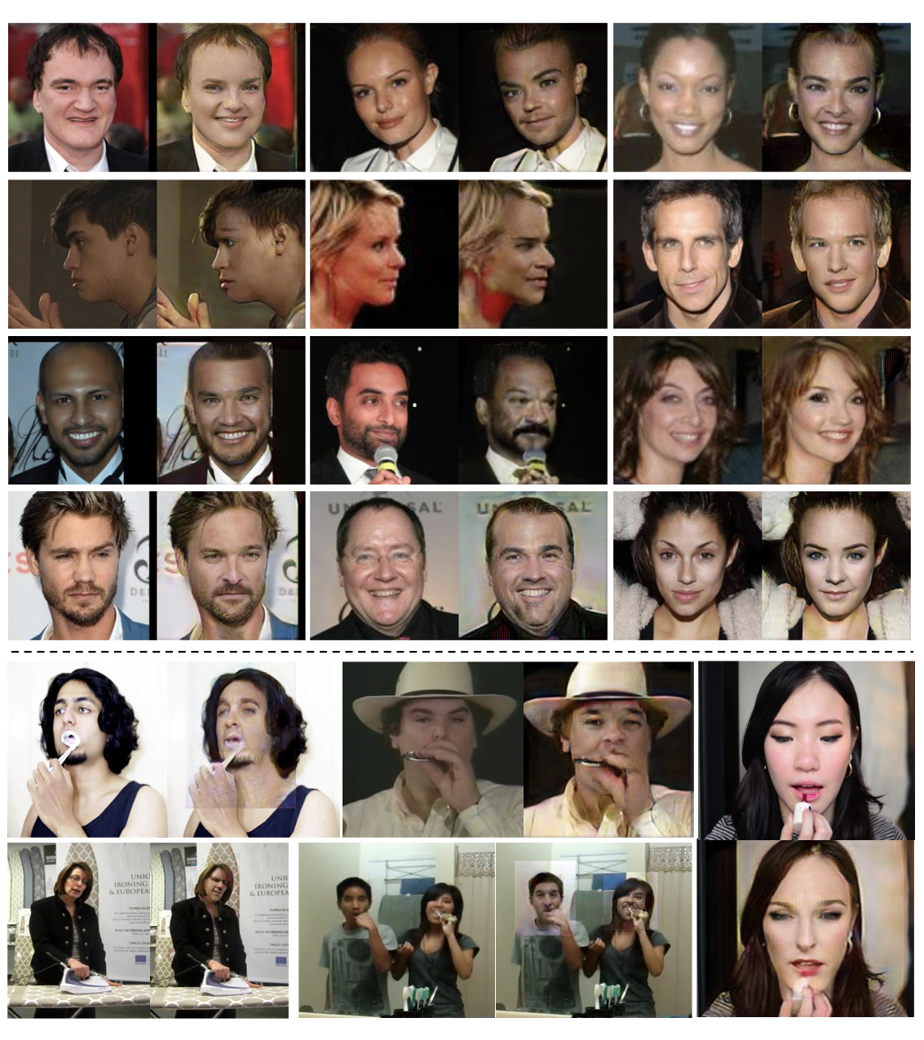

Slide 20


